Slide 1
Pro Football Reference
Team 5
ANU VERMA
JONATHAN RUCINSKI
SAIPREETHI SUNKU SAMUEL TERR VISHNU CHANDRA ADUSUMILLI
XINYUE CHEN

Slide 2
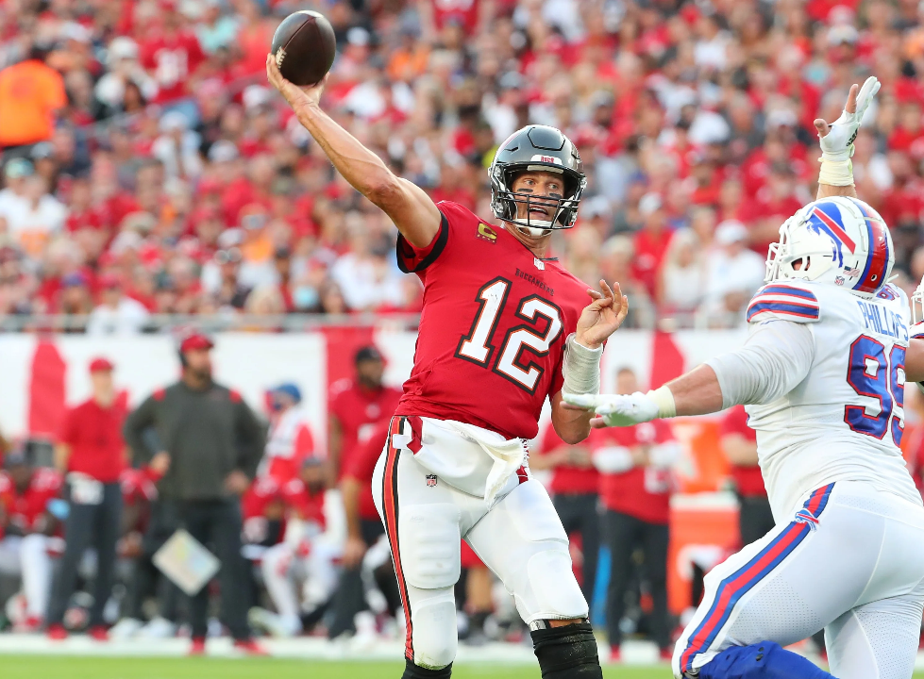
Topic Definitions
National Football League (NFL) – a professional sports organization located in the U.S. which showcases American football
Football – the sport American football
Quarterback (QB) – the player on offense who throws/passes the ball
Running Back (RB) – the player on offense who runs/rushes the ball
Wide Receiver (WR) – a player on offense who receives the ball
Tight End (TE) – a player on offense who receives the ball
Touchdown – the primary method of scoring points in the NFL
Yards – the measurement used for depicting positive/forward progress down the football field
Division – a collection of four teams in the NFL where their ranking determines their advancement to the playoffs
Superstar – a player who is ranked top 10 at their position
Reed, M. (2023). Tom Brady Bucs v. Bills. How to watch NFL 2023. Expert Reviews. Retrieved
March 18, 2023, from https://www.expertreviews.co.uk/streaming/1416645/how-to-watch-nfl.

Slide 3

Topic Scraping data from pro-football-reference.com
What is PFR?
Pro-Football-Reference (PFR) is an extension of Sport-Reference.com which is a platform that collects statistics for the four major professional sports organizations (NFL, NBA, MLB, & NHL) within the United States
Each organization has their own unique base URL to organize and store their own sports data (i.e. https://www.pro-football-reference.com/)
PFR is the location for all American football related data since 2015
Pro Football Stats, history, scores, standings, playoffs, Schedule & Records. Pro Football Reference. (n.d.). Retrieved March 12, 2023, from https://www.pro-football-reference.com/

Slide 4
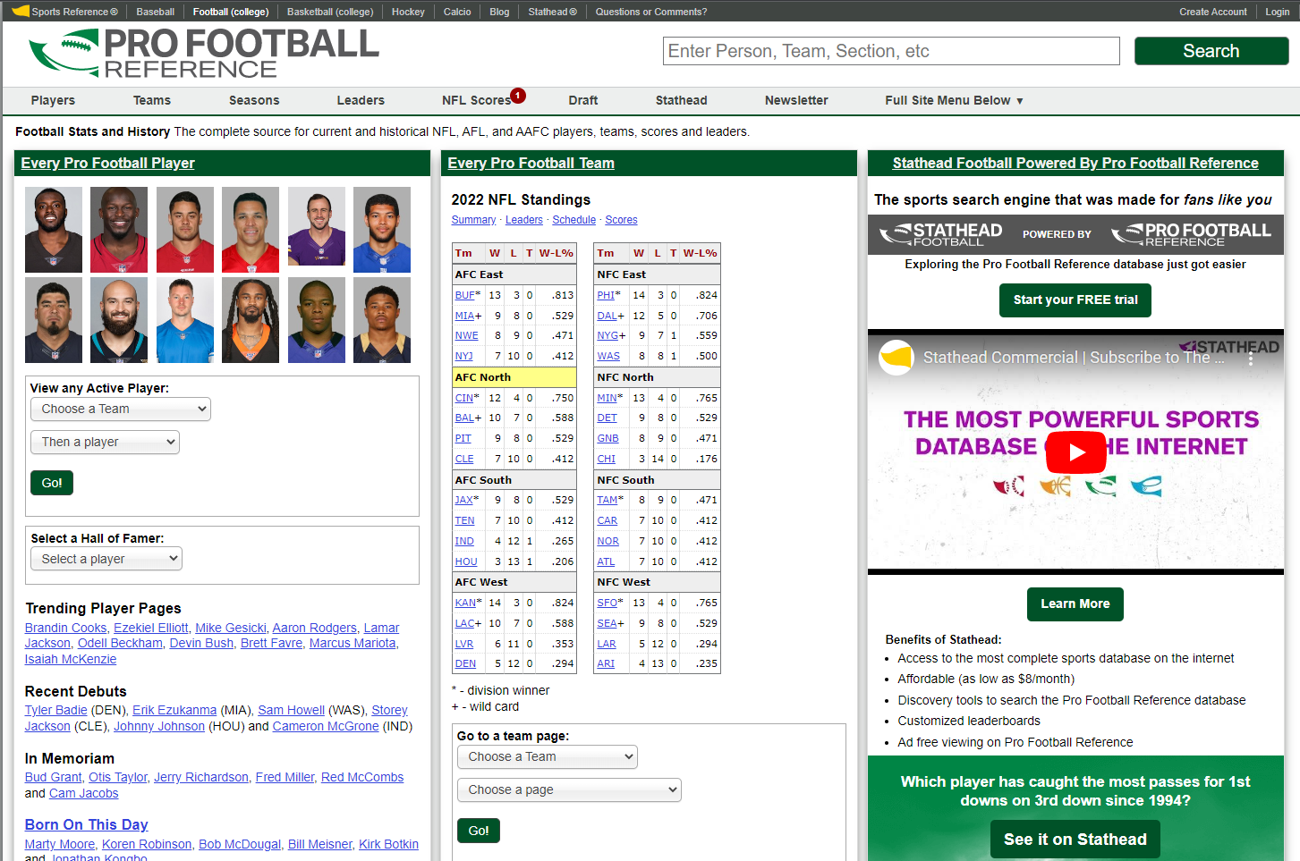
Topic Pro-football-reference.com
How will be using the website?
Gathering all offensive player statistics and team's division rankings from 2018-2022
Seasons ⇒ Fantasy
Contains all offensive statistics for every player in the NFL (sorted by season)
Seasons ⇒ Team Stats & Standings
Contains division rankings and basic team statistics (win-loss ratio, points for, points against, etc.)
Pro Football Stats, history, scores, standings, playoffs, Schedule & Records. Pro Football Reference. (n.d.). Retrieved March 12, 2023, from https://www.pro-football-reference.com/

Slide 5
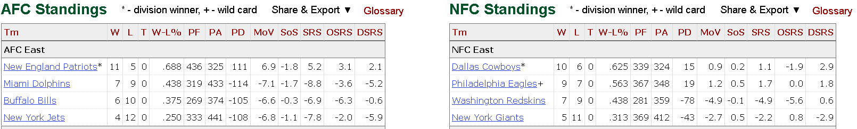
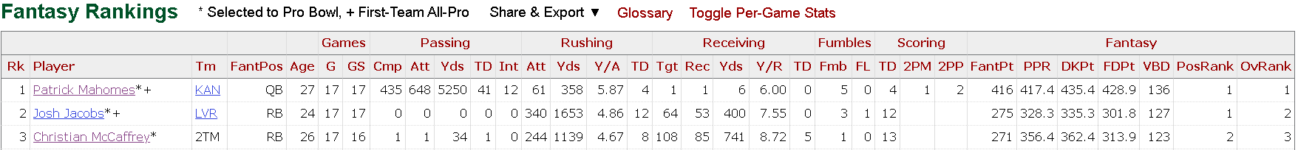
Data source Specific URLS
Team Stats and Standings 2018-2022
2. Fantasy 2018-2022
E.g. https://www.pro-football-reference.com/years/2022/index.htm
Research Purpose: To find out the yearly division winners.
E.g. https://www.pro-football-reference.com/years/2022/fantasy.htm
Research Purpose: To gather offensive player statistics that will be utilized for positional ranking.
Pro Football Stats, history, scores, standings, playoffs, Schedule & Records. Pro Football Reference. (n.d.). Retrieved March 12, 2023, from https://www.pro-football-reference.com/

Slide 6
Data source Legal
“SRL believes in data democratization—open access to data and the tools that use it … Moreover, we encourage the sharing and reuse of data and statistics our users find on our Site as a general matter…”
“Our guiding principles are that (1) sharing, using, modifying, repackaging, or publishing data found on individual SRL webpages is welcomed, whether for commercial or non-commercial purposes, but (2) any such sharing, use, modification, repackaging, or publication should explicitly credit SRL as the source of the data to the maximum extent possible…”
Sports Reference Terms of Use
Pro Football Stats, history, scores, standings, playoffs, Schedule & Records. Pro Football Reference. (n.d.). Retrieved March 12, 2023, from https://www.pro-football-reference.com/

Slide 7
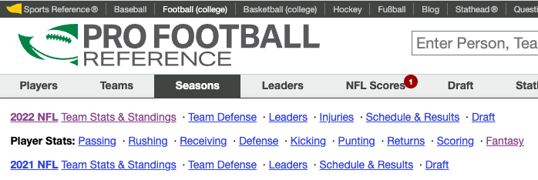
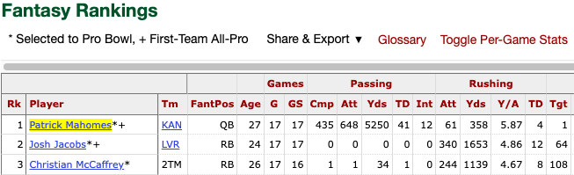
Web Scraping Examining layout and Understanding structure
Website has a typical hierarchical HTML structure:
Head: metadata and information about scripts and stylesheets used on the page
Body: main content- football statistics in a tabular format
Top Navigation: menu to view other sections of the website, view football stats by year
HEAD AND NAVIGATION
BODY
Understanding URL structure:
Base URL, ‘years’ stats, ‘year’, type of player stats
Pro Football Stats, history, scores, standings, playoffs, Schedule & Records. Pro Football Reference. (n.d.). Retrieved March 12, 2023, from https://www.pro-football-reference.com/
Notes:
The pro football reference website has relatively simple html has a hierarchial html structure with

Slide 8
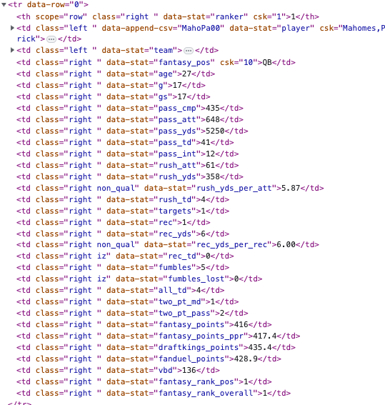
Web Scraping TOOLS AND METHODLOGY
Methodology
HTML and CSS
Libraries used: Beautiful Soup, Requests, Pandas
Replaced year value in the URL using string formatting and used FOR loop to iterate through webpages*
Relevant columns were extracted using HTML tags and CSS class names and attributes^
For example, Player name was extracted using the tag “td” and attribute “player”
Text extracted using .text() method
Data for each column was appended to a list of the same name using list comprehension
*
^

Slide 9
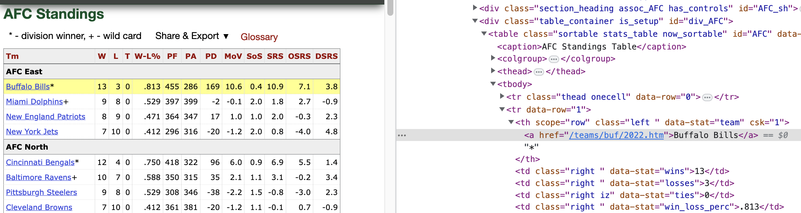
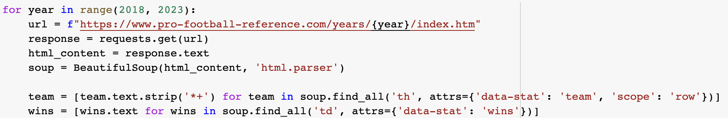
Web Scraping TOOLS AND METHODLOGY
Methodology
HTML and CSS
We followed a similar approach to extract data from ‘standings’ pages, suing for loop to iterate through webpages
The URLs follow a similar structure and were extracted using string formatting
Table information was extracted using HTML tags ‘th’ and ‘td’ and ‘data-stat’ attributes
To maintain a flat dataframe and avoid extracting division names, attribute ‘scope’ was specified to extract only team names
Division names were later added in a separate column

Slide 10
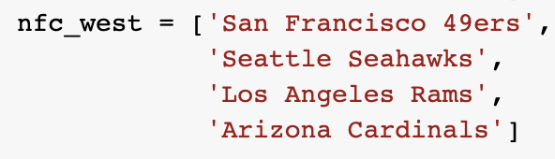
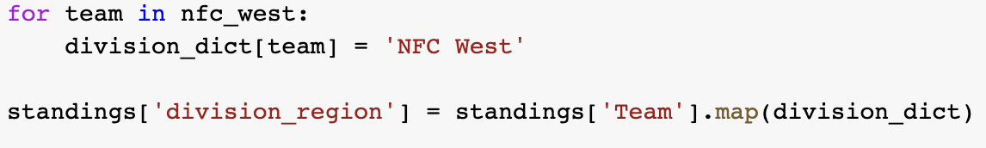
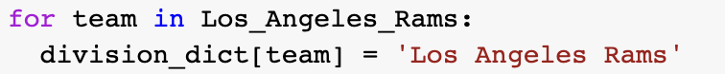
Data Cleaning Extracting year, adding division column
Extracting year from URL for both Standings and NFL dataframes
Stored URL for every row scraped
Extracted year from URL using regular expression and stored it in a new column called ‘Year’
Adding division names
‘Division’ column was added to the NFL data to contain division names
Adding full team names
Team name abbreviations were converted to complete names and mapped using map method
Renaming teams to reflect the latest developments
Washington Redskins, Washington Football Team → Washington Commanders
Oakland Raider → Las Vegas Raiders
Converting relevant columns to numeric

Slide 11
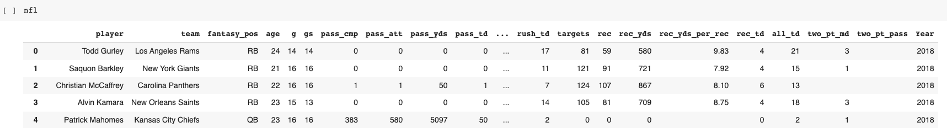
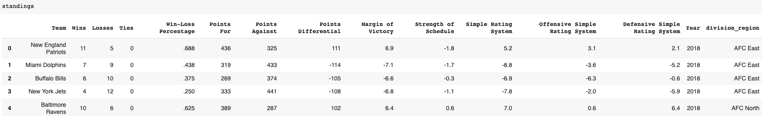
RESULTS NFL and Standings dataframes
NFL Fantasy Dataframe
Standings Dataframe

Slide 12
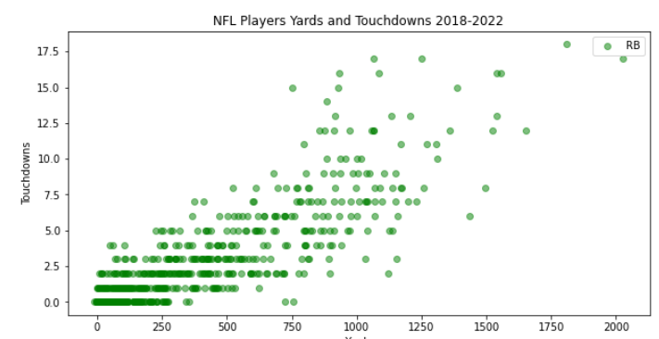
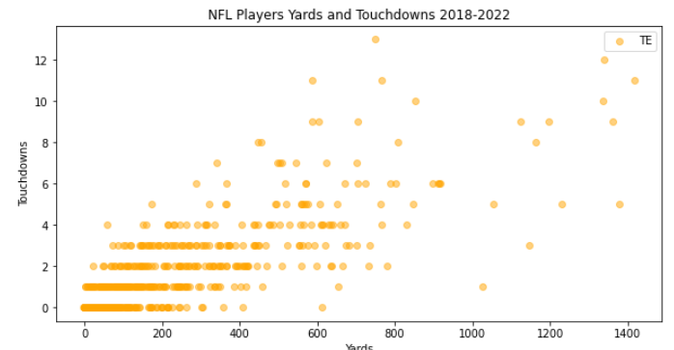
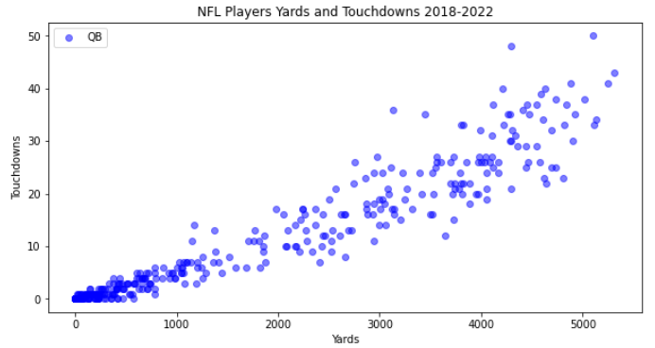
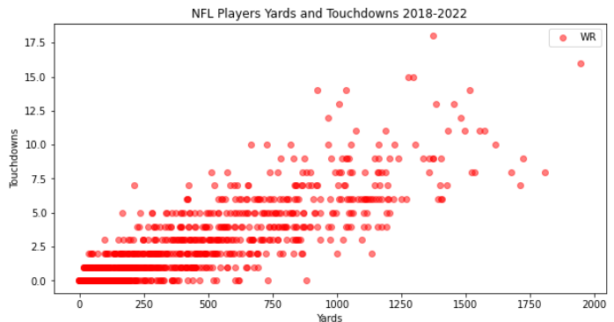
Visualization Plot of QB,RB,TE &WR players for the year(2018-2022)
QB players
RB players
TE players
WR players

Slide 13
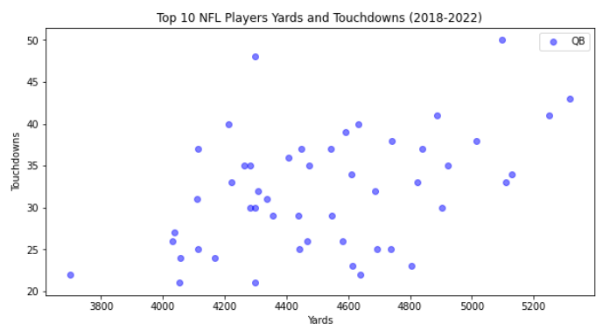
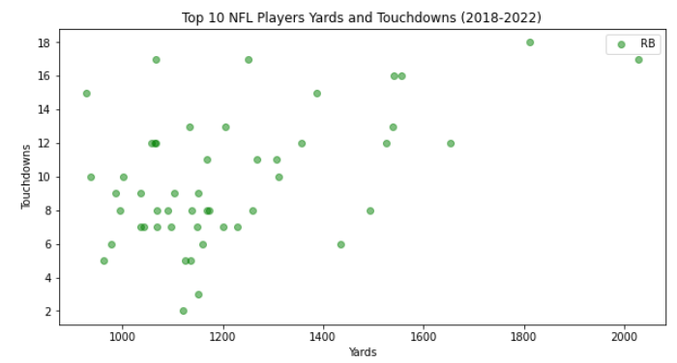
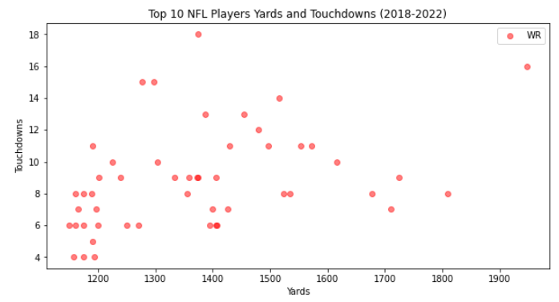
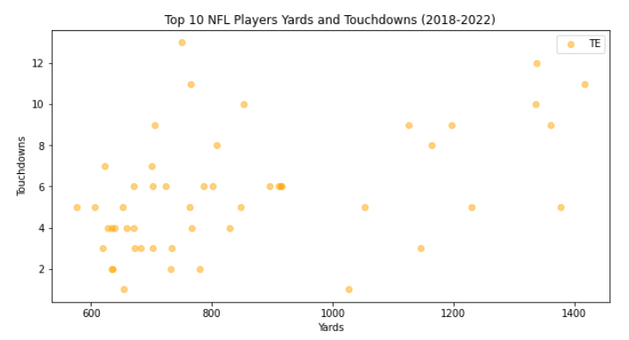
Visualization Top 10 NFL players Yards & Touchdowns for the year(2018-2022)
QB players
RB players
WR players
TE players

Slide 14
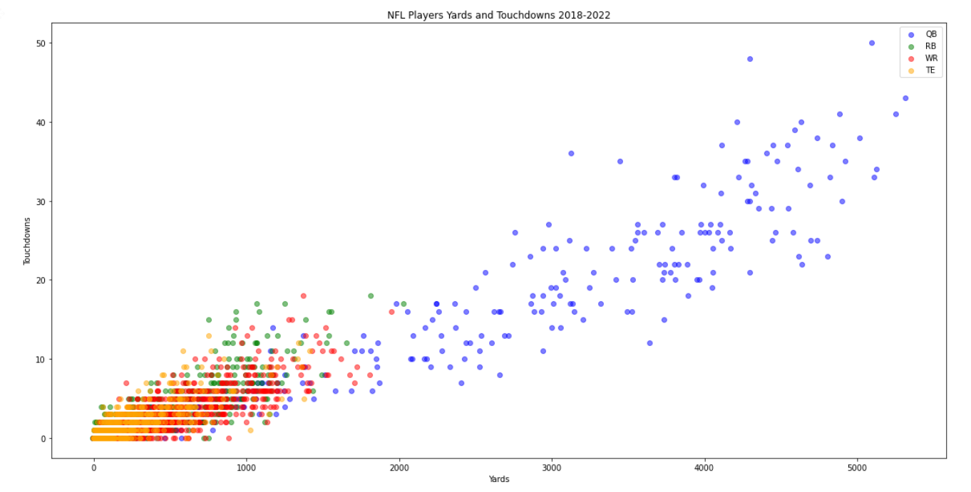
Visualization Plot for all players in the year 2018-2022
Maximum yards and touchdown in the year 2018-2022 for NFL is QB players
Least yards and touchdowns can be observed for TE players
Trend can be seen in QB players from 2018-2022

Slide 15
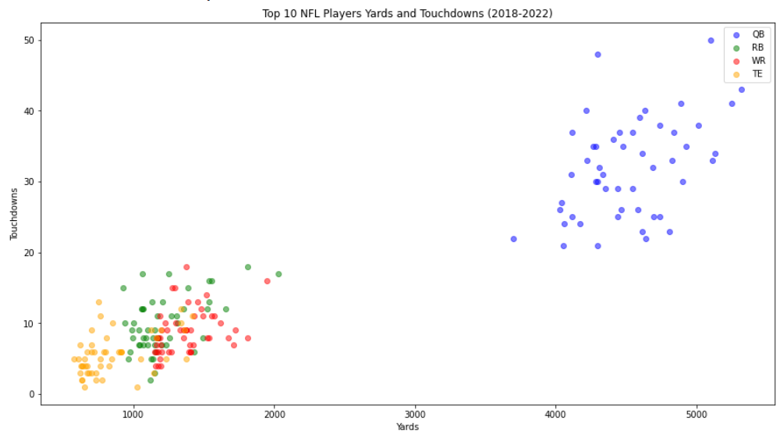
Visualization Top 10 NFL players by Yards and Touchdowns
QB players are standing out from all other players in the top 10 list of NFL players yards and touchdowns 2018-2022
Other players(TE,WR,RB) has minimum yards and touchdowns(2018-2022)

Slide 16
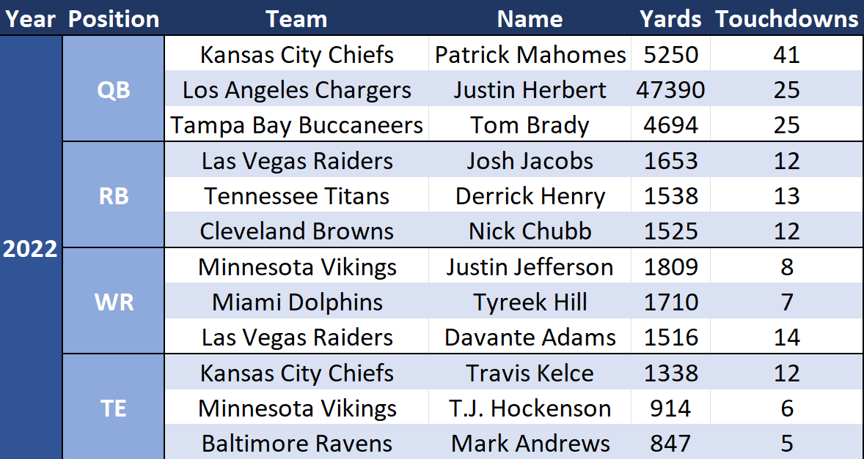
Analysis Top 10 players – Example Output

Slide 17
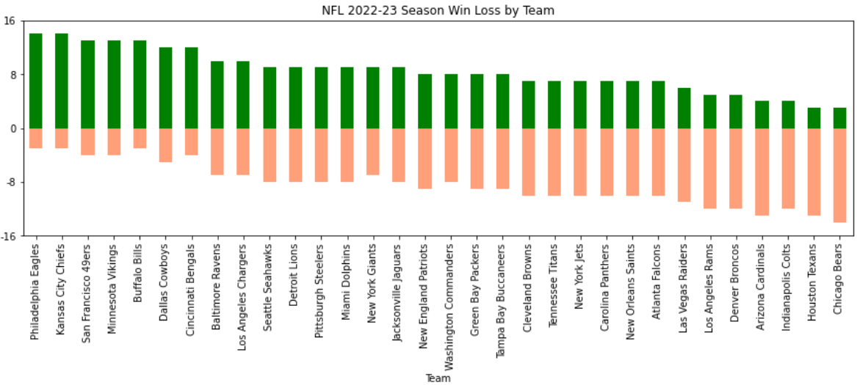
Visualization NFL 2022-2023 season win loss by team
In 2022-23 season
Philadelphia Eagles and Kansas City Chiefs had the best win-loss record(14-3).
Chicago Bears had the worst win-loss record (3-14).

Slide 18
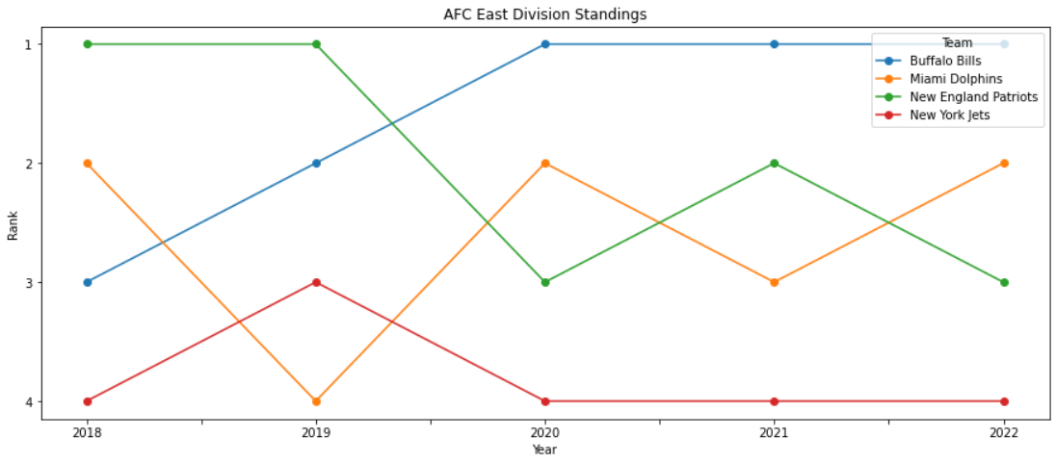
Visualization Line Graph for Division Team rankings 2018-2022 Seasons
Buffalo Bills have improved performance over time resulting in their sustained position at the top of the division since 2020
In 2018, the Dolphins and Patriots emerged as the leading contenders, they have since traded places between second and third ranking in subsequent years.
Despite team changes, the Jets remain the lowest contender in the division.

Slide 19
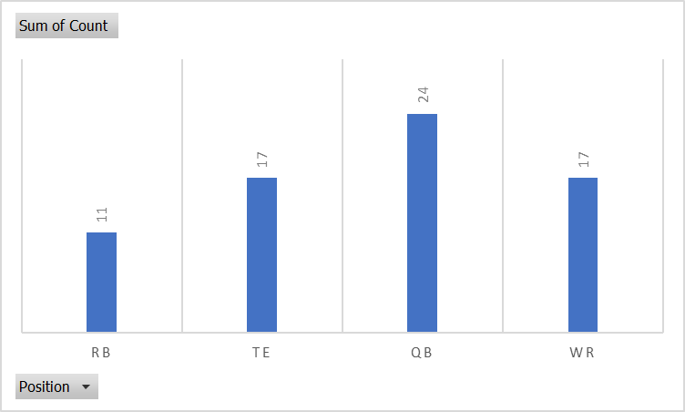
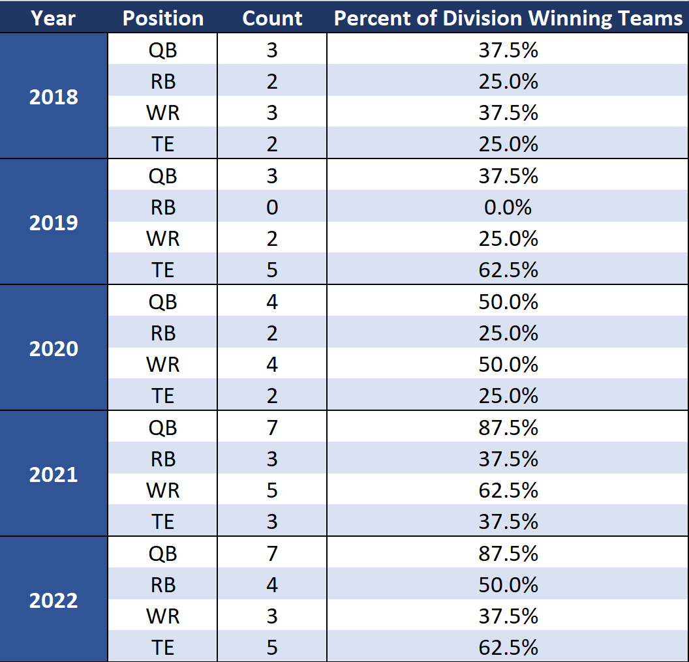
Analysis impact of each position on winning teams
Which position had the biggest impact over 5 seasons?
Yearly breakdown
Notes:
37.5% of top 10 QBs were on a team that won their division in 2018.

Slide 20
Takeaways
Key Takeaways
Over a five year period, it is clear that the most impactful position at determining a division winning team is the quarterback position.
Over this span, the impact of the quarterback position trends from less than half the division winning teams (3) in 2018 has a superstar quarterback to nearly every single division winning team in 2022 has a superstar quarterback (7).

Slide 21
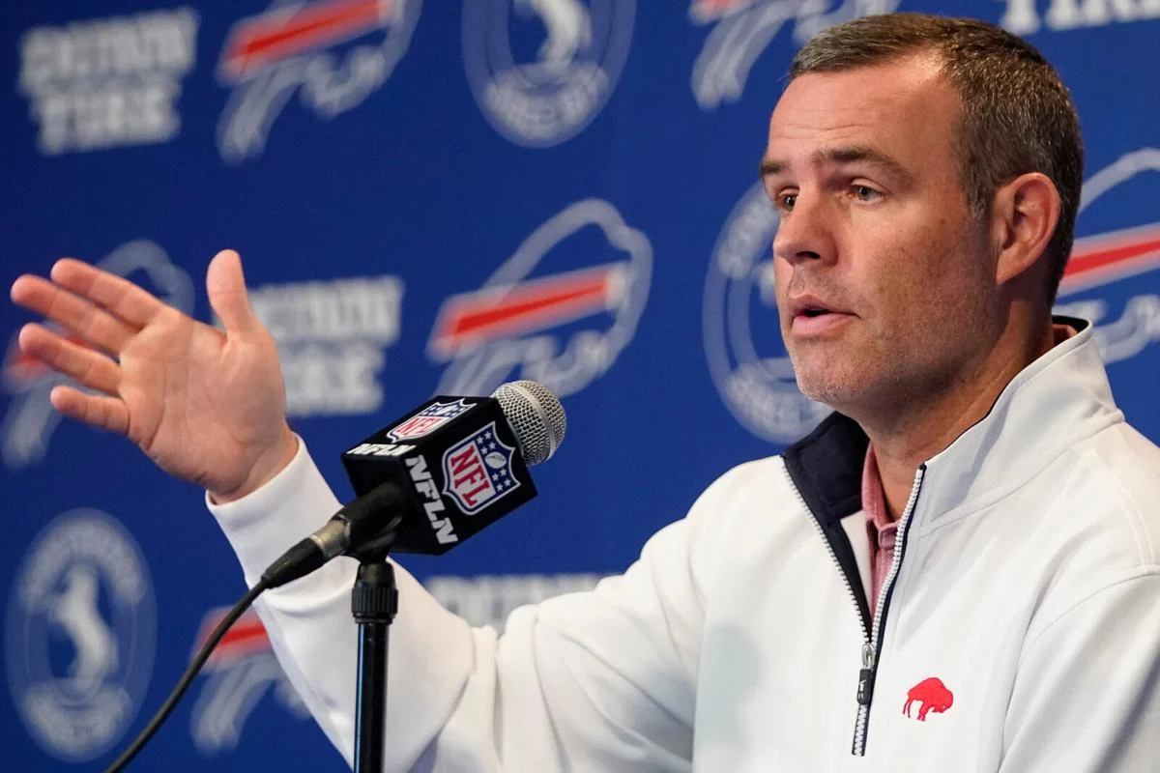
Going Forward Contract Structure
The Salary Cap Problem
NFL GMs need to justify the players they acquire in addition to the contracts that they give them.
Determining how the best offenses are structured can give insight as to how an underperforming team needs to improve their roster.
Salary cap distribution
2022 cap: $208.2 million distributed among 53 rostered players
Top 10 QBs in 2022 accounted for $16.04 million of their teams' salary cap on average
Maximum: $35.8 million
Minimum: $1.6 million
Skurski, J. (2023, March 18). Observations: Brandon Beane says bills 'loved, didn't want to lose' Tremaine Edmunds. Buffalo News. Retrieved March 20, 2023, from https://buffalonews.com/sports/bills/observations-brandon-beane-says-bills-loved-didnt-want-to-lose-tremaine-edmunds/article_d5d33518-c455-11ed-b3f1-ff25b721dfde.html

Slide 22

Thank you for your attention! We welcome any questions that you may have.

